Slide 1
Introduction to Machine Learning
Lei Qian, Ph.D.

Slide 2
What is Machine Learning
Machine learning is a subfield of Computer Science that explores the study and construction of algorithms that can learn from and make predictions on data without having to program
Examples:
Speech Recognition
Object detection
Playing games
Medical diagnosis

Slide 3
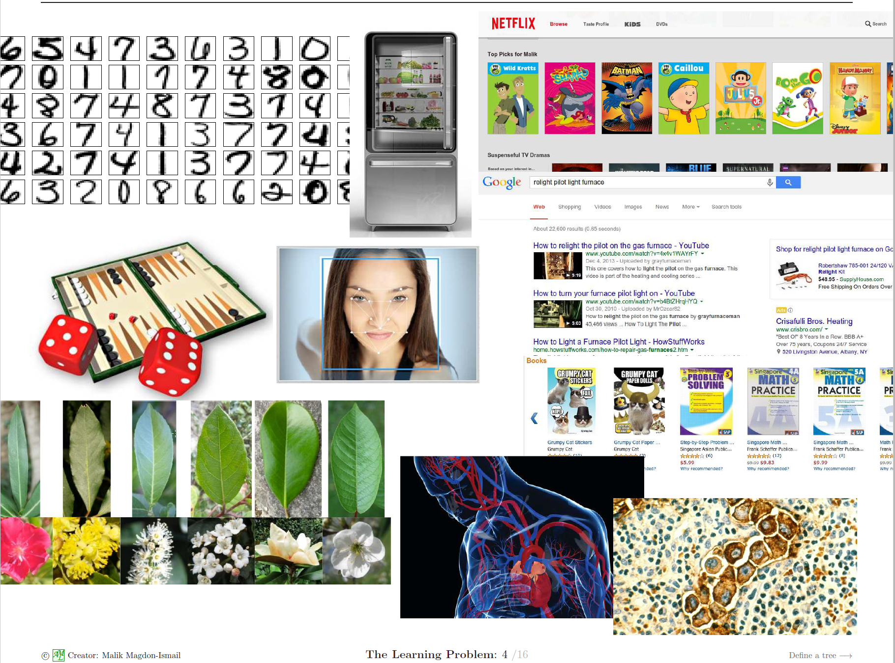

Slide 4
What is Artificial Intelligence
In computer science, artificial intelligence (AI), sometimes called machine intelligence, is intelligence demonstrated by machines. It is a broader concept comparing to Machine Learning.
The term "artificial intelligence" is often used to describe machines (or computers) that mimic "cognitive" functions that humans associate with the human mind, such as "learning" and "problem solving"
Challenges of AI includes reasoning, problem solving, knowledge presentation, etc.
Methods of AI includes symbolic reasoning, statistical learning etc.
Difference between AI and ML: ML learns from data and AI does not need.
Difference between ML and DL: DL usually refers to ML methods that applies some variations of artificial neural networks with many layers.

Slide 5
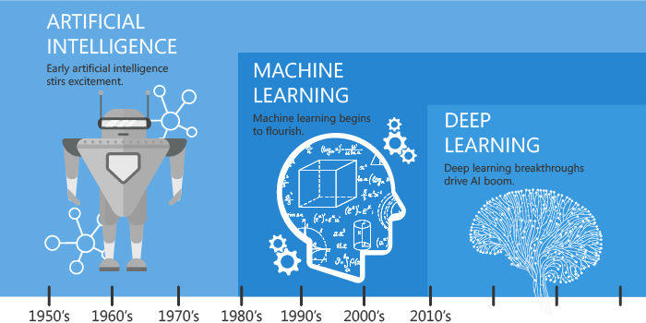
What is Artificial Intelligence
https://hackernoon.com/difference-between-artificial-intelligence-machine-learning-and-deep-learning-1pcv3zeg

Slide 6
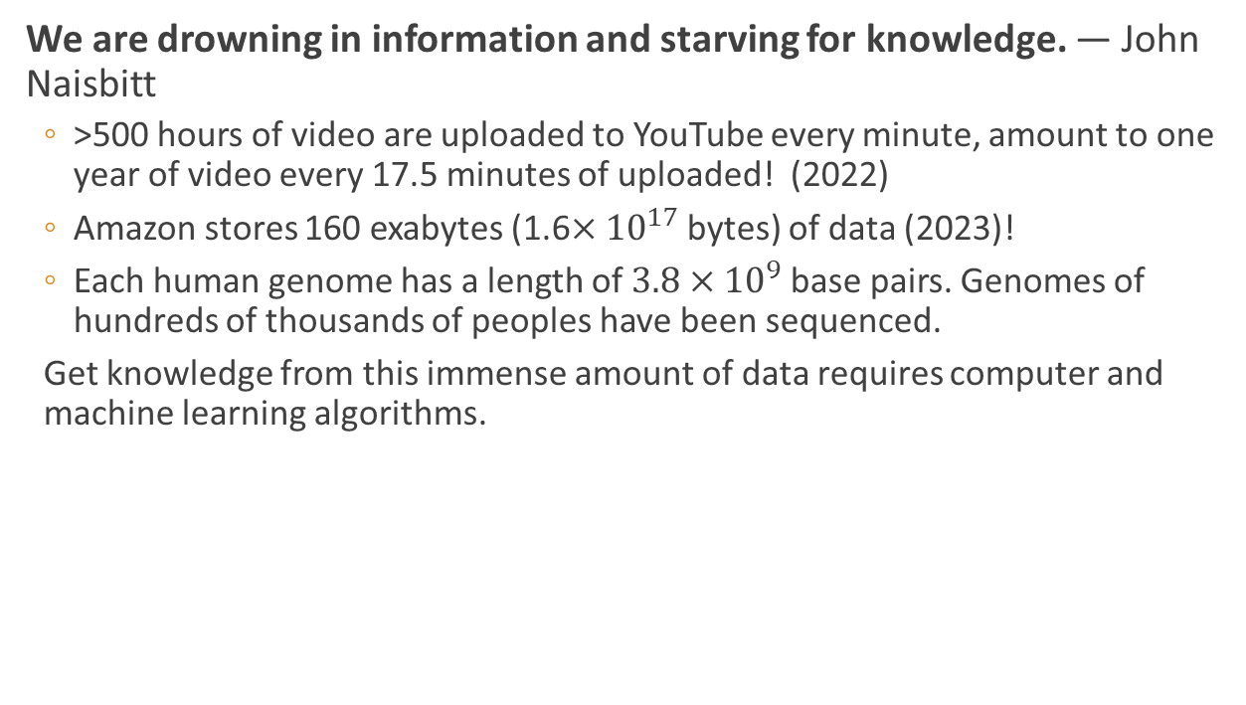
Why machine learning:
We are drowning in information and starving for knowledge. — John Naisbitt
>500 hours of video are uploaded to YouTube every minute, amount to one year of video every 17.5 minutes of uploaded! (2022)
Amazon stores 160 exabytes (1.6$×{10}^{17}$ bytes) of data (2023)!
Each human genome has a length of $3.8×{10}^{9}$ base pairs. Genomes of hundreds of thousands of peoples have been sequenced.
Get knowledge from this immense amount of data requires computer and machine learning algorithms.

Slide 7
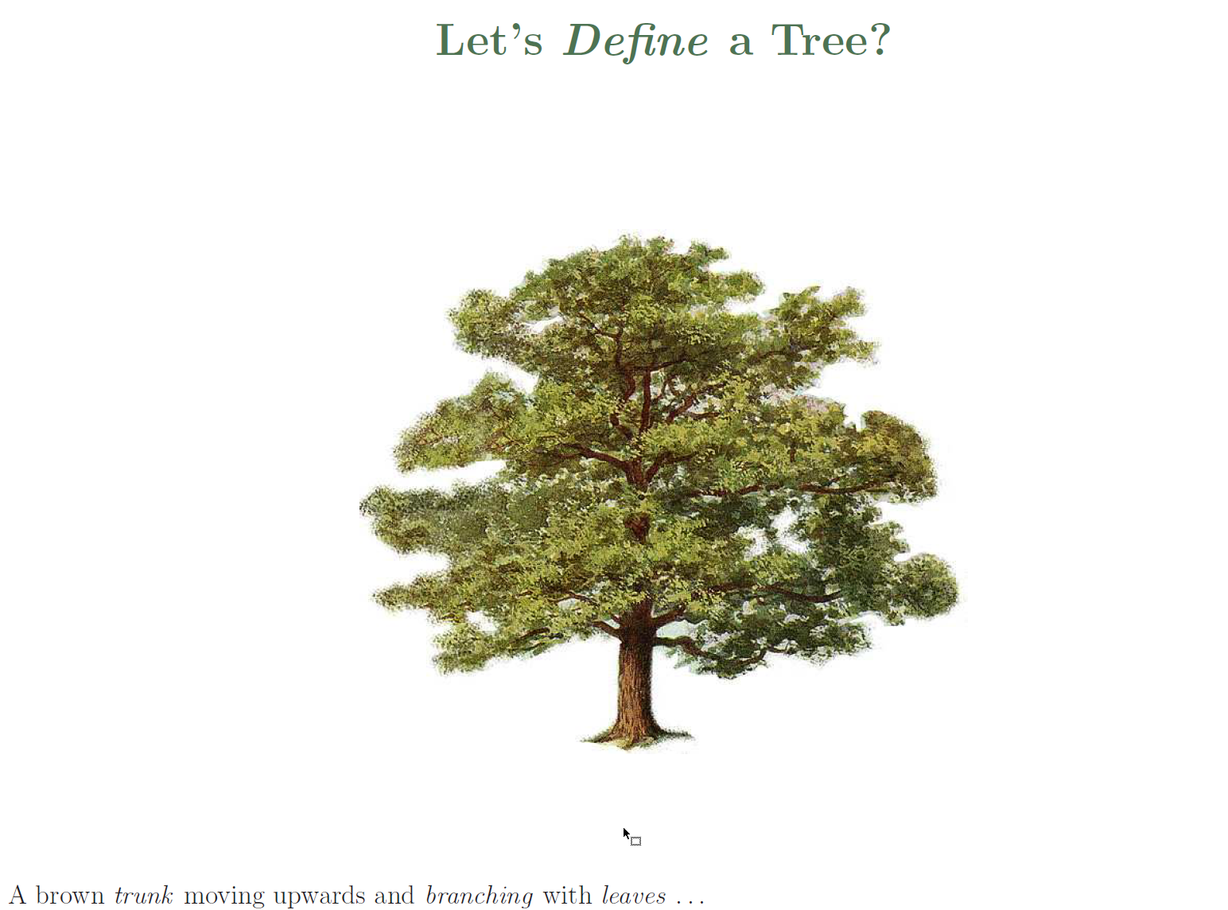

Slide 8
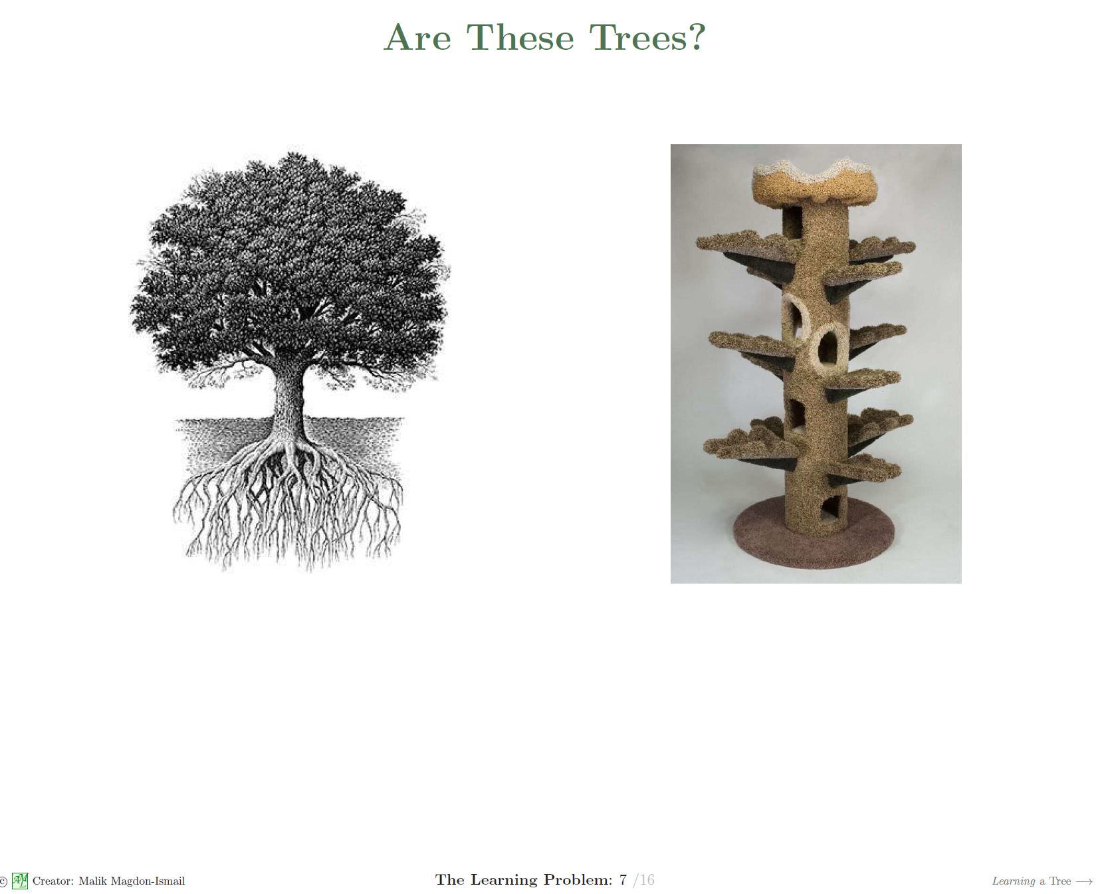

Slide 9
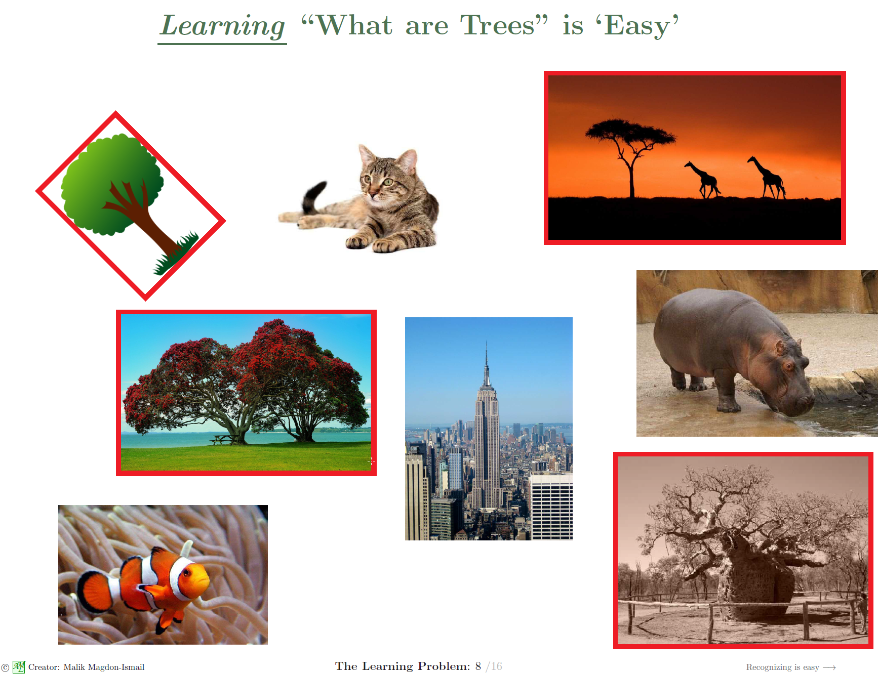

Slide 10
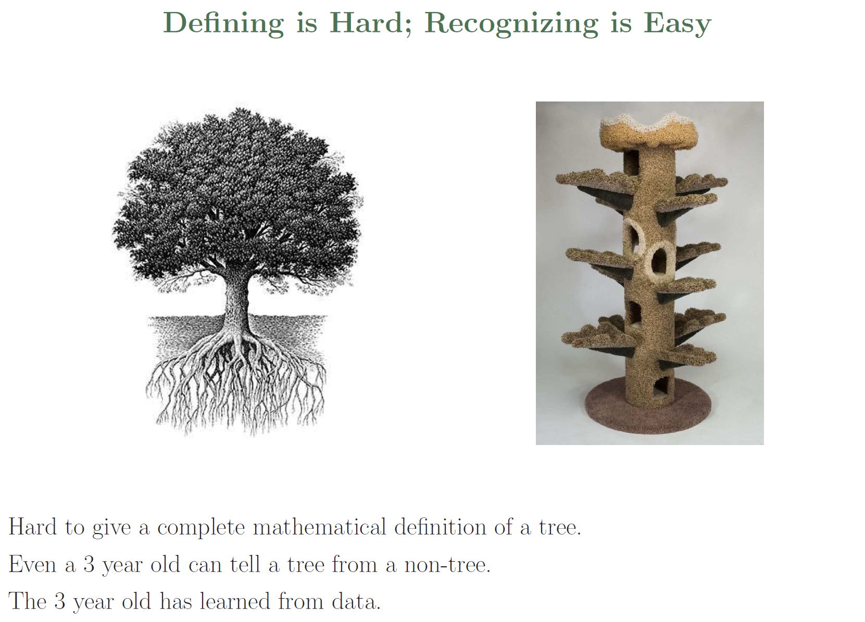

Slide 11
How machine learning works?
1. Machine learning needs data to train models.
Image data
Audio data
Text data
Other numerical data (length, age, rating, price, etc)
Categorical data (gender, positive/negative, shape, types etc)
2. We can apply machine learning only when data has patterns.
3. If the problem has explicit mathematics formulas, we do not need machine learning.

Slide 12
What problems are not suitable for applying ML/DL?
Problems not suitable for ML:
When the traditional approach is a better option. When you can apply simply rule-based system.
When you do not have much data.
Problems not suitable for DL:
When you need explainability. Deep learning models are typically uninterpretable.
When errors are unacceptable.

Slide 13
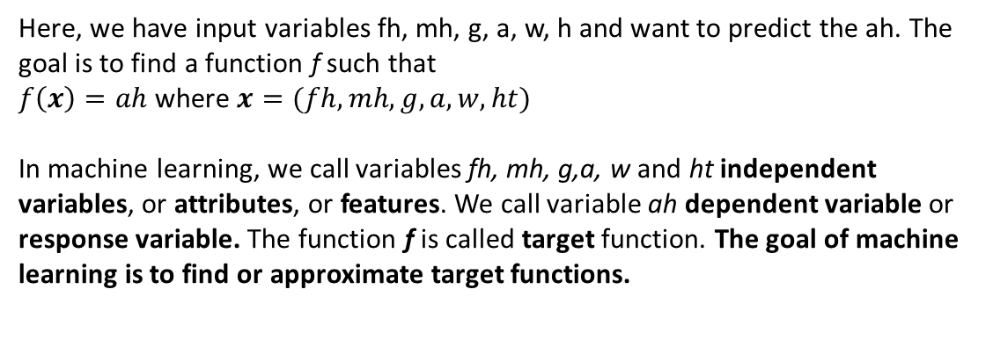
How machine learning works?
Example: we want to predict children's adult height. We have the following data:
Fa Ht | Mo Ht | Gender | Age | Wt (lbs) | Ht | Adult Ht
6'2" | 5'6" | M | 4 y 2 m | 40 | 4'1" | 6'3"
5'6" | 5'4" | M | 5 y 1m | 39 | 4'2" | 5"8"
5'10" | 5'5" | F | 7 y 3m | 60 | 4'9" | 5'6"
… | … | … | … | … | … | …
Here, we have input variables fh, mh, g, a, w, h and want to predict the ah. The goal is to find a function f such that
$f\left(x\right)=ah$ where $x=(fh, mh, g, a, w, ht)$
In machine learning, we call variables fh, mh, g,a, w and ht independent variables, or attributes, or features. We call variable ah dependent variable or response variable. The function f is called target function. The goal of machine learning is to find or approximate target functions.

Slide 14
Types of machine learning
Machine learning is usually divided into three types:
Supervised learning
Unsupervised learning
Reinforcement learning.
Supervised learning is by far the most widely used.
Other by-product of machine learning:
Generative models
Autoencoder
Transformers (ChatGPT)

Slide 15
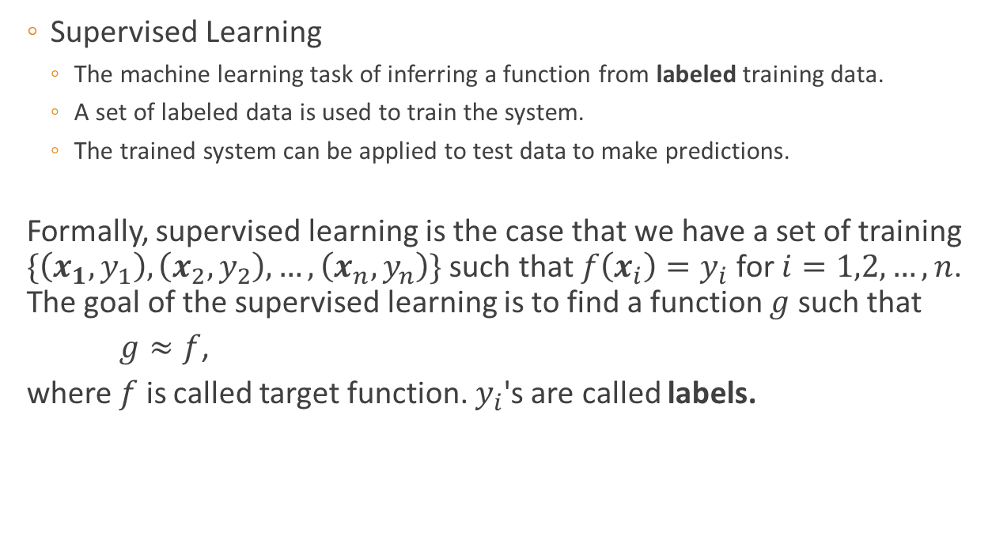
Supervised Learning
Supervised Learning
The machine learning task of inferring a function from labeled training data.
A set of labeled data is used to train the system.
The trained system can be applied to test data to make predictions.
Formally, supervised learning is the case that we have a set of training $\{\left(x_{1},y_{1}\right), \left(x_{2},y_{2}\right), …, \left(x_{n},y_{n}\right)\}$ such that $f\left(x_{i}\right)=y_{i}$ for $i=1,2,…,n$. The goal of the supervised learning is to find a function $g$ such that
$g≈f$,
where $f$ is called target function. $y_{i}$'s are called labels.

Slide 16
Supervised Learning
Example:
Recognizing objects in images
Identifying spam emails
Predicting stock prices
Natural language recognition
Protein structure prediction
Children adult height prediction

Slide 17
Supervised Learning
Supervised Learning can be categorized into regression and classification
Regression: the dependent variable is a real value variable.
Predict stock price
Predict children's adult height
Classification: the dependent variable is a categorical variable
Classify an email to SPAM or non-SPAM (2-classes).
Predict what objects are in a picture (multiple classes)
Predict if an audience likes a movie (2-classes)
Some problems can be treated either as a regression problem or a classification problem. For example, predict the letter grade of a student in the final exam giving his/her midterm, quizzes and homework assignment scores.

Slide 18
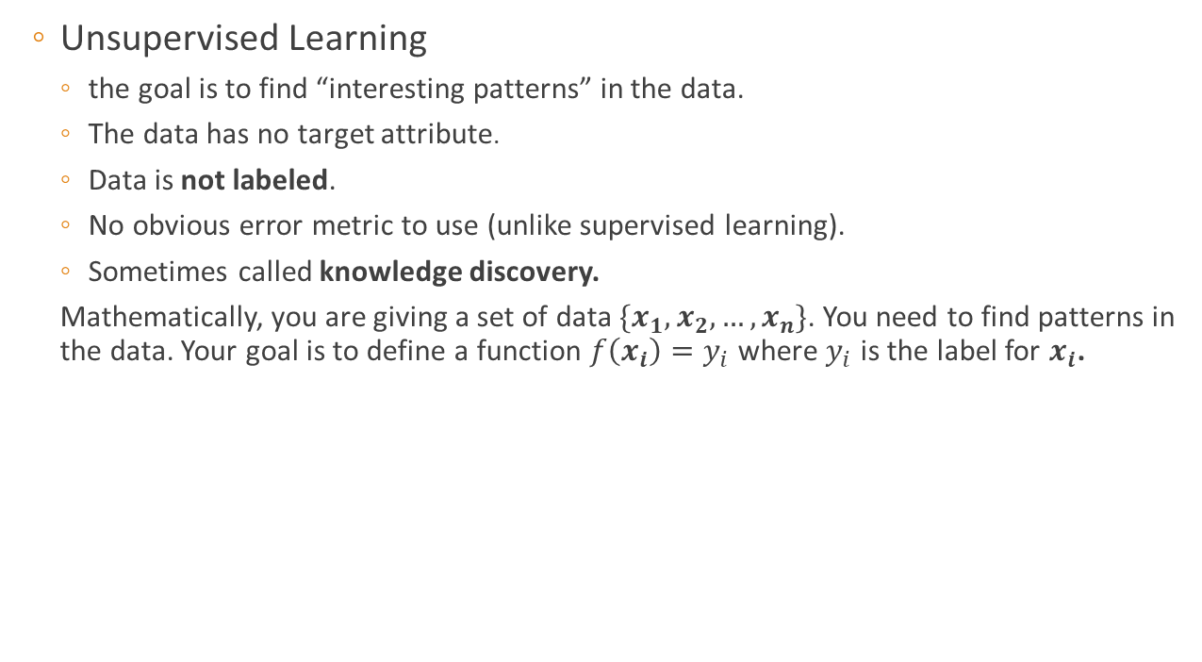
Unsupervised Learning
Unsupervised Learning
the goal is to find “interesting patterns” in the data.
The data has no target attribute.
Data is not labeled.
No obvious error metric to use (unlike supervised learning).
Sometimes called knowledge discovery.
Mathematically, you are giving a set of data $\{x_{1},x_{2}, …,x_{n}\}$. You need to find patterns in the data. Your goal is to define a function $f\left(x_{i}\right)=y_{i}$ where $y_{i}$ is the label for $x_{i}$.

Slide 19
Unsupervised Learning
Unsupervised Learning
Examples:
An conference organizer received 1000 papers. He/she needs to divide these 1000 authors to 20 different groups depends on the similarity of the contents.
Zillow groups its housing listings into neighborhoods, price ranges etc so that it can recommend houses similar to houses a users has browsed.
Data scientists reduce the number of dimensions in a large data set to simplify modeling and reduce file size.
Approaches includes
Clustering
Hidden Markov Models
Dimensionality reduction

Slide 20
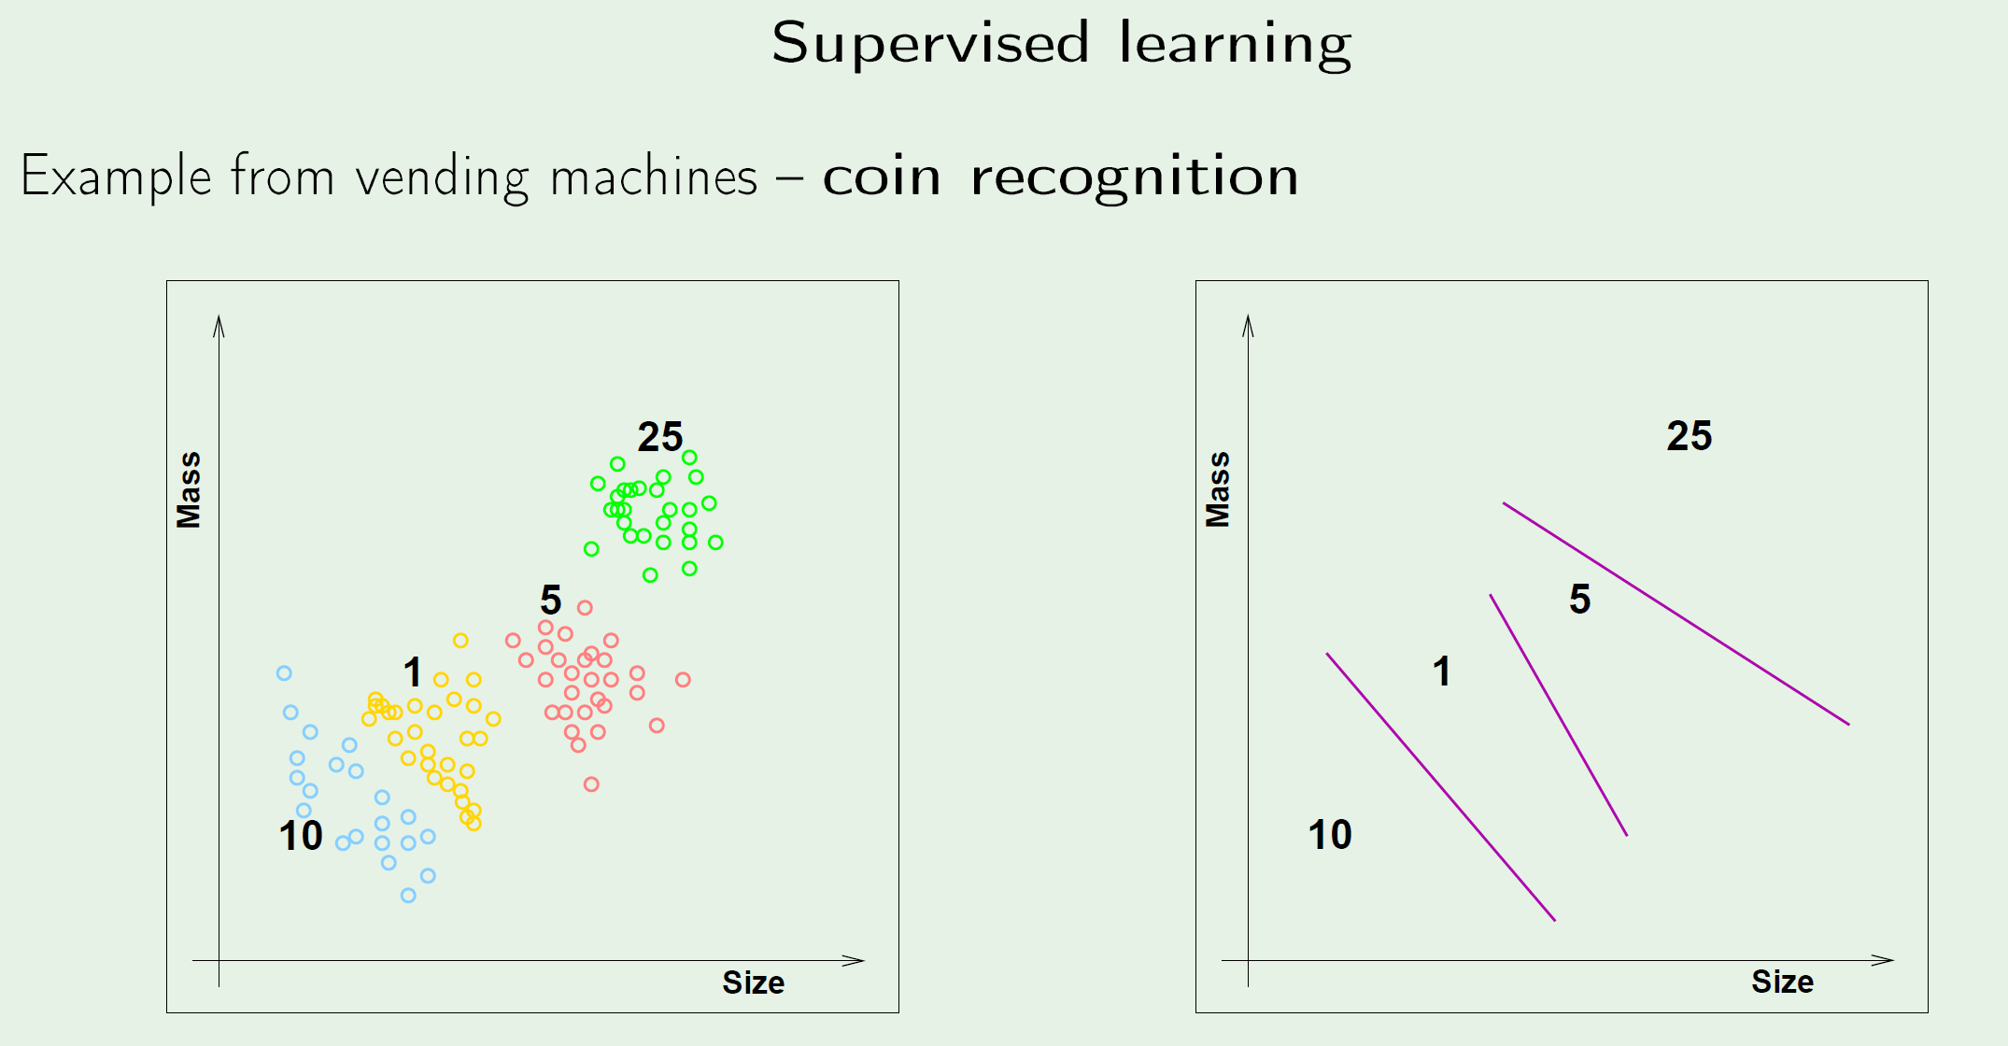

Slide 21
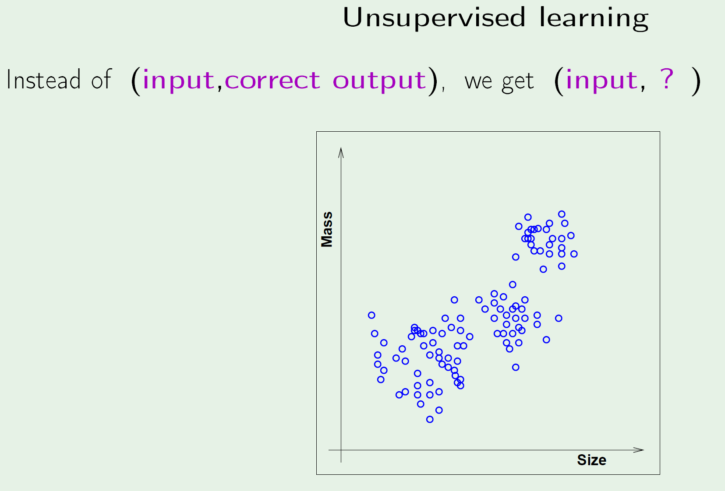

Slide 22
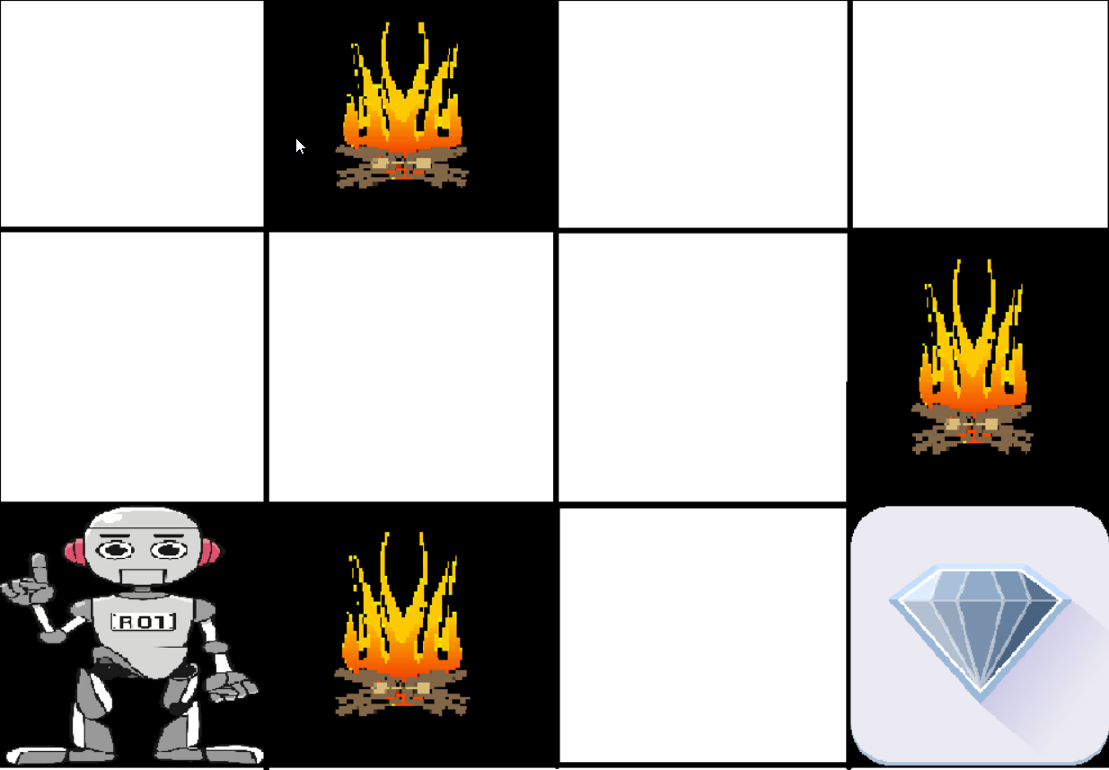
Reinforcement Learning
Reinforcement learning is to find actions to maximize reward in certain environments. It is widely used in game theory, control theory and many other areas.
Example: The goal of the robot is to get the reward that is the diamond and avoid the hurdles that is fire. The robot learns by trying all the possible paths and then choosing the path which gives him the reward with the least hurdles. Each right step will give the robot a reward and each wrong step will subtract the reward of the robot. The total reward will be calculated when it reaches the final reward that is the diamond.

Slide 23
Reinforcement Learning
Main points in reinforcement learning:
Input: The input should be an initial state from which the model will start
Output: There are many possible output as there are variety of solution to a particular problem
Training: The training is based upon the input, The model will return a state and the user will decide to reward or punish the model based on its output.
The model keeps learning.
The best solution is decided based on the maximum reward.
Applications:
Playing strategy games
Autopilot

Slide 24
Other by productions of ML
Generative Models
Informally:
Generative models can generate new data instances.
Discriminative models discriminate between different kinds of data instances.
More formally, given a set of data instances X and a set of labels y:
Discriminative models capture the conditional probability p(y|X).
Generative models capture the joint probability p(X, y), or just p(X) if there are no labels.

